Slide 1
Unit 2 DECISIONS AND MATH OPERATIONS
ICS3U/ICS3C

Slide 2
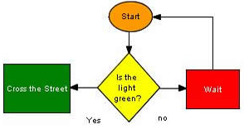
WHAT IS AN IF STATEMENT?

Slide 3
MAKING DECISIONS
We make decisions in life all the time
We need our programs to be able to make decisions too… deciding what code to execute under different circumstances

Slide 4
BINARY DECISIONS
Even complicated decisions can be reduced to “binary” (two choices) decisions, if we break them up into enough steps
Like our stoplight example… if it is green, you cross, if it is not… do something else.

Slide 5
BOOLEANS
When using “ifs” for decisions you will get lots of practice with your Boolean values – “If” happens if something is TRUE or not if it is FALSE
The easiest/simplest thing is to check if a variable equals a certain value: if (myNumber == 7) { //do this stuff }
Notice the double “=“ sign! One equals sign MAKES something equal that value.
Two equals signs indicates that you’re CHECKING if it’s equal but not changing the value

Slide 6
OTHER BOOLEAN OPERATORS
! – “not” as in (value != 1)
&& - “and” as in (value1 > 10 && value1 < 50)
|| - “or” as in (value1 > 10 || value2 >= 15)
< less than
> Greater than
<= less than or equal to
>= greater than or equal to

Slide 7
SYNTAX OF AN “IF”
We set up our code for an “if” using a Boolean statement (remember – Boolean means true or false!)
if (Boolean value is true)
{code to run if it is true}

Slide 8
SYNTAX OF AN “IF”
If there is only one line of code to run in the “if” you do not NEED the braces “{“ “}” around the code but it never hurts to include them (especially if you think you might go back and add more lines of code)
if (Boolean value is true)
{code to run if it is true;
More code to run;}

Slide 9
OTHER PARTS OF AN “IF”… ELSE
Sometimes we want a line of code to run only in a certain case. That just requires an “if” statement.
More often, we want one line or chunk of code to run in a certain case, and other code to run if it’s a different case. That requires an “ELSE”

Slide 10
OTHER PARTS OF AN “IF”… ELSE
if (Boolean value is true)
{code to run if it is true;
More code to run;}
else
{code to run if that Boolean was false}
The code in an “Else” will run in ANY CASE where the “if” did not happen!!!

Slide 11
OTHER PARTS OF AN “IF”… ELSE IF
Lots of times we have more than just 2 cases though… so we need more than if and else
The last piece of the “if” decision making family is else if
While you can have only one “if” and one “else” per decision you can have as many “else if”s as you want!

Slide 12
OTHER PARTS OF AN “IF”… ELSE IF
if (Boolean value #1 is true)
{code to run if it is true;}
else if (Boolean value #2 is true)
{code to run if it is true}
else
{code to run if neither #1 nor #2 were true}

Slide 13
OTHER PARTS OF AN “IF”… ELSE IF
The order of these decision statements REALLY matters here.
Once one “if” or “else if” is true, the program will evaluate that code and then SKIP all the rest of the statements right to the end of the last “else”
So only ONE of these will run
It is important for you to think critically and use logical reasoning to figure out the best order if there are times when more than one of the Booleans could be true.

Slide 14
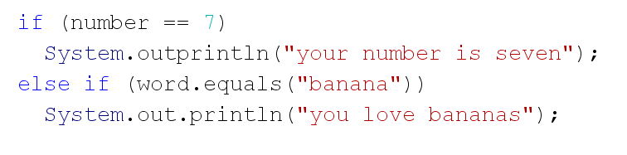
COMPARING STRINGS
We cannot use the “==” to check if a string equals a value
We must use the “stringName.equals(“ “) as shown below:

